Slide 1
Create virtual machine
MANOJ KUMAR

Slide 2
Enter virtual machines in the search.
Under Services, select Virtual machines.
In the Virtual machines page, select Create and then Azure virtual machine. The Create a virtual machine
Enter virtual machines in the search.
Under Services, select Virtual machines.
In the Virtual machines page, select Create and then Azure virtual machine. The Create a virtual machine page opens.
Under Instance details, enter manoj-vm for the Virtual machine name and choose Windows Server 2019 Datacenter - Gen 2 for the Image. Leave the other defaults.

Slide 3
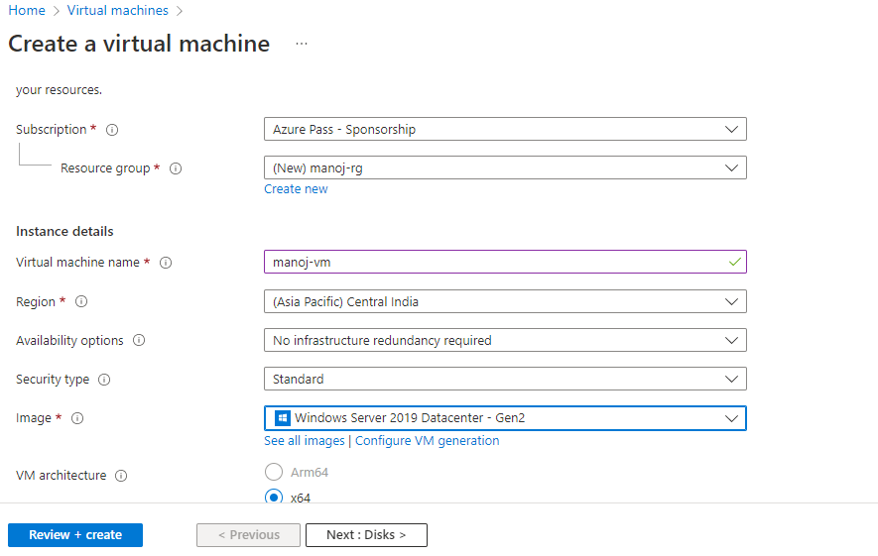

Slide 4
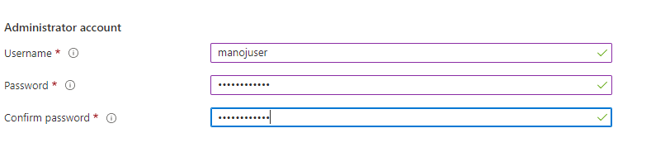
Under Administrator account, provide a username, such as manojuser and a password. The password must be at least 12 characters

Slide 5
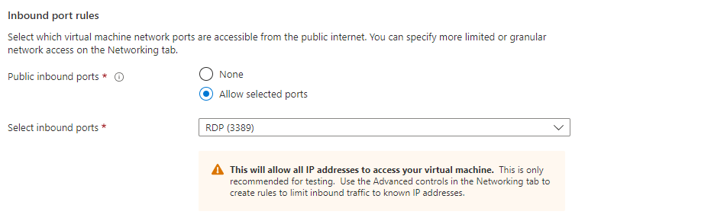
Under Inbound port rules, choose Allow selected ports and then select RDP (3389) and HTTP (80) from the drop-down.

Slide 6
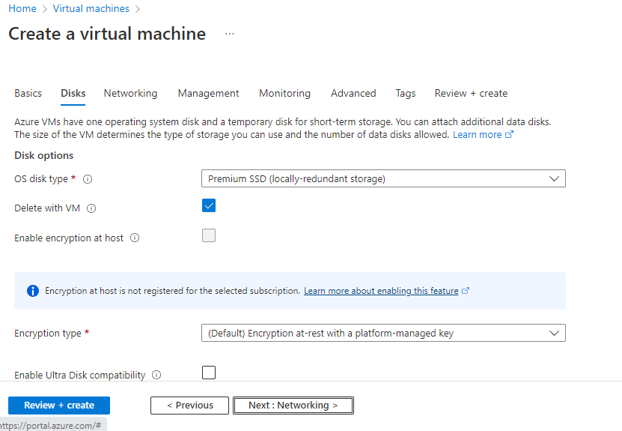

Slide 7
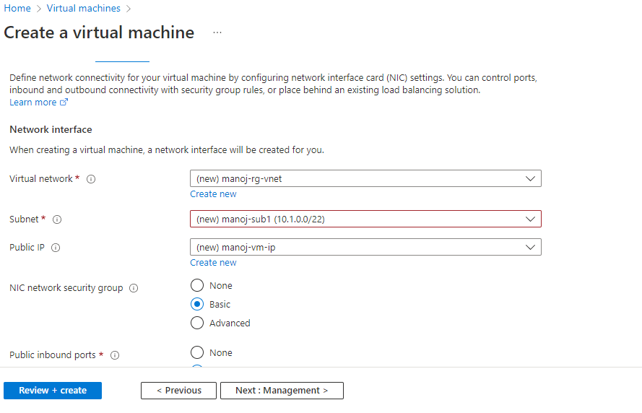

Slide 8
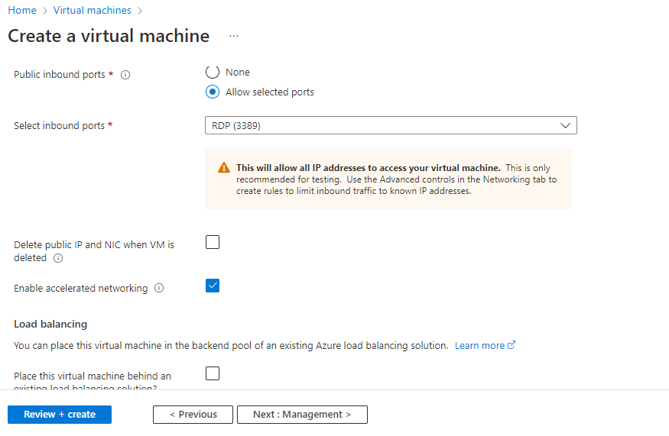

Slide 9
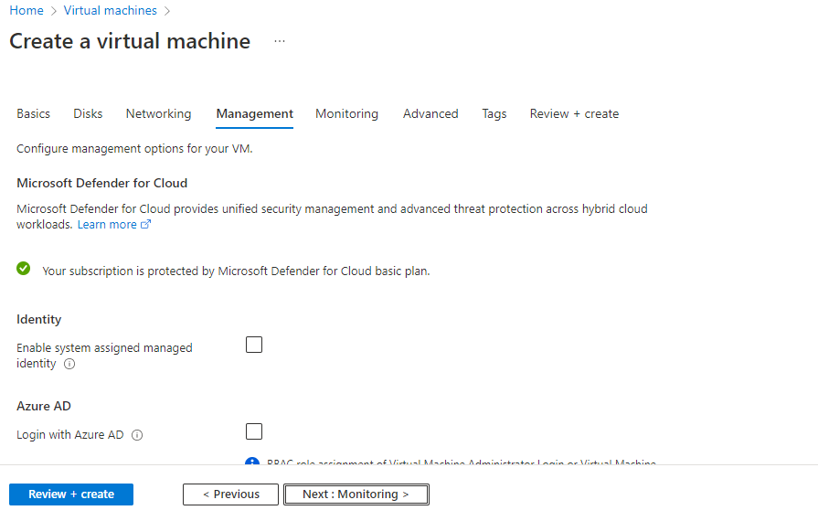

Slide 10
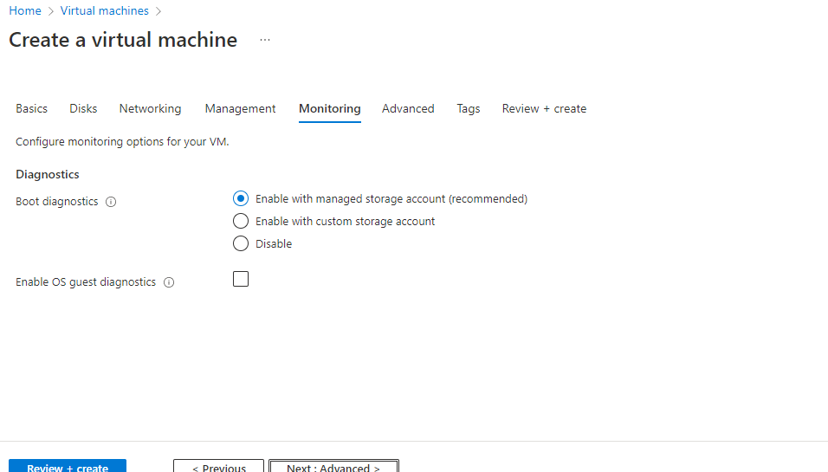

Slide 11
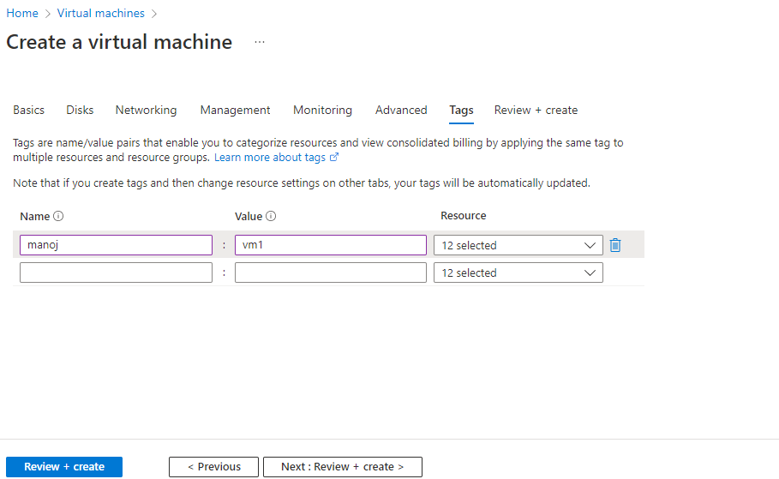

Slide 12
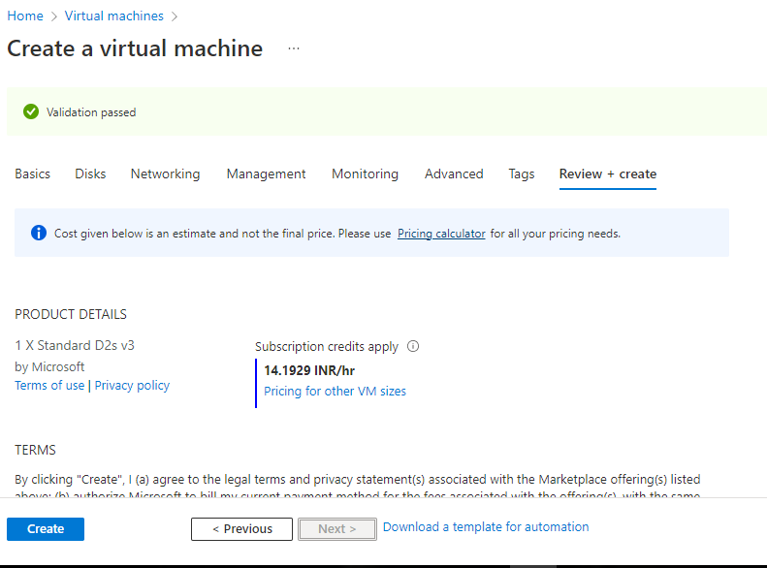

Slide 13
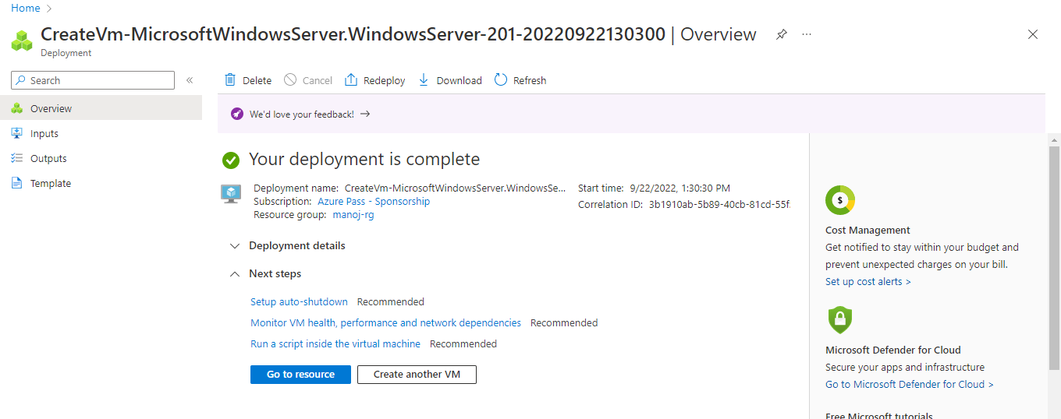
After deployment is complete, select Go to resource.

Slide 14
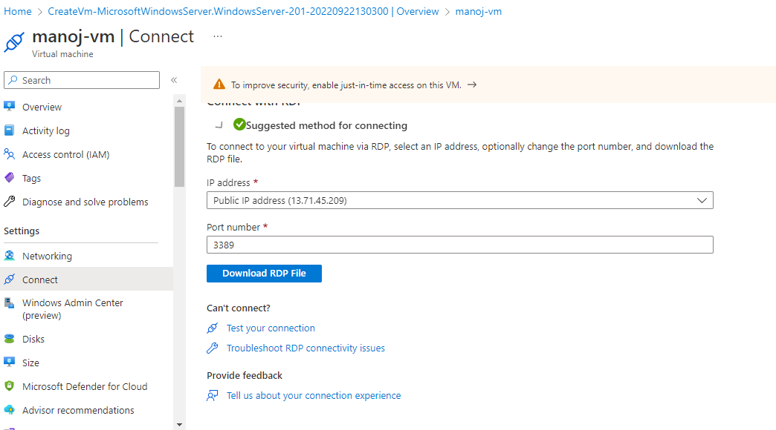
On the overview page for your virtual machine, select the Connect > RDP.

Slide 15
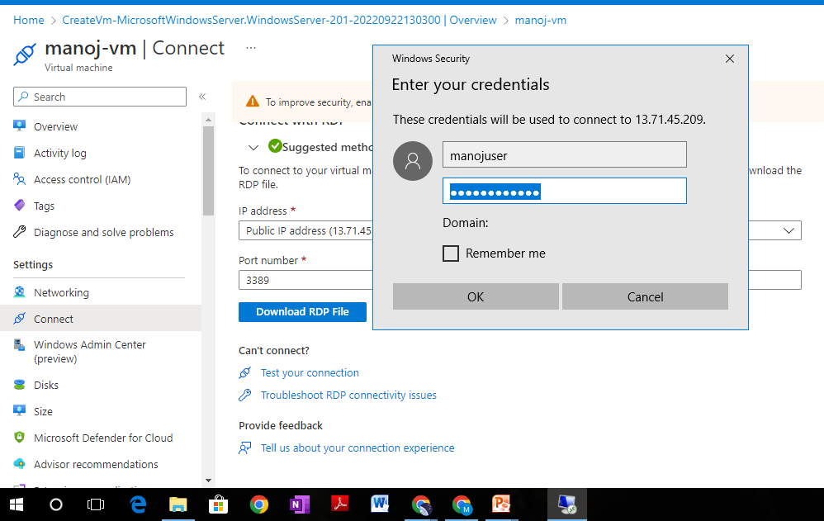

Slide 16
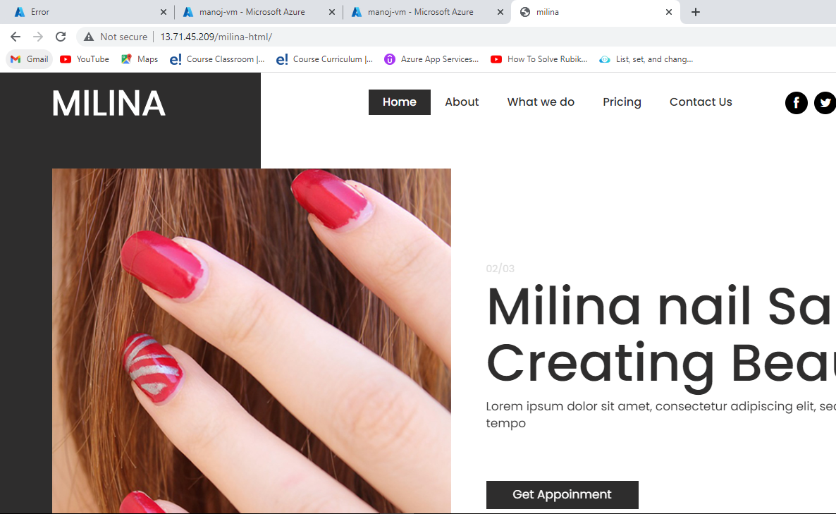
Successfully host the css file in vm

